Slide 1


Introduction to Video Production & Editing and Career
This training session will provide a strong foundation for participants to understand the basics of video production and the necessary tools for a successful career in the field.
by Akbar Hossan

Slide 2
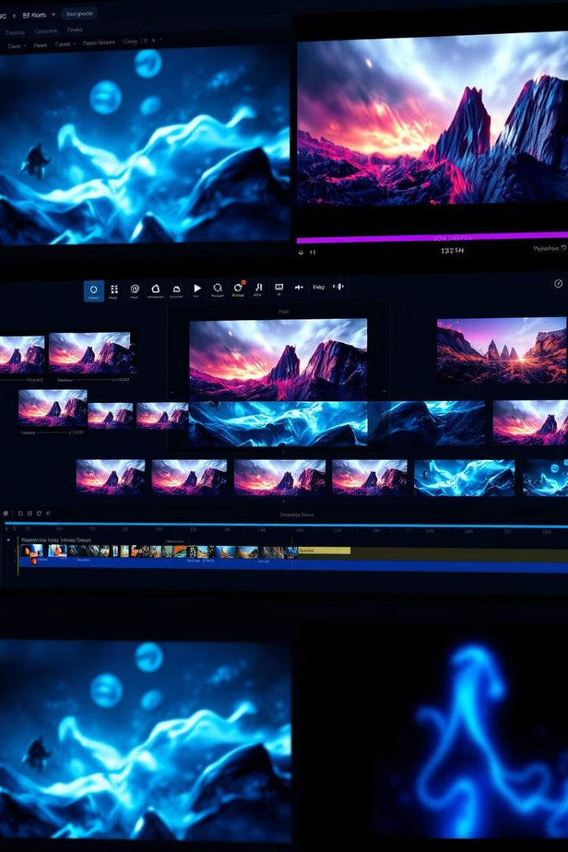
Introduction to Video Production & Editing
1
What is Video Production & Editing?
Video production involves capturing footage, while editing involves manipulating and refining that footage.
2
Importance of Editing
Editing is essential for storytelling, creating a polished final product, and engaging viewers.
3
Stages of Video Production
The process involves pre-production, production, and post-production.
4
Pre-Production
This stage includes planning, scripting, and storyboarding.

Slide 3
Essential Software for Video Production & Editing
Video Editing Software
Audio Editing Software
Other Tools
Adobe Premiere Pro, Final Cut Pro, DaVinci Resolve are widely used.
Audacity and Adobe Audition are popular choices for audio editing.
After Effects is used for motion graphics, and Photoshop for visual elements.

Slide 4

Careers in Video Production & Editing
Role
Description
Videographer
Operates the camera and shoots video footage.
Video Editor
Edits video content, cuts footage, adds transitions, sound, etc.
Sound Engineer
Mixes and edits soundtracks.
Technical Director
Manages production equipment and technical aspects of the shoot.
Director
Oversees the creative direction of the project.
News Producer
Manages video content in news organizations.
Assignment Editor
Allocates tasks in newsrooms and media houses.
Graphics Editor/Producer
Creates visual elements for video content.

Slide 5

Career Skills & Growth Opportunities
1
Attention to Detail
Meticulousness is crucial for video production and editing.
2
Creativity and Innovation
The ability to think outside the box is essential for success.
3
Proficiency in Software Tools
Mastering video editing software is a must.
4
Communication and Teamwork
Effective communication and collaboration are vital.

Slide 6
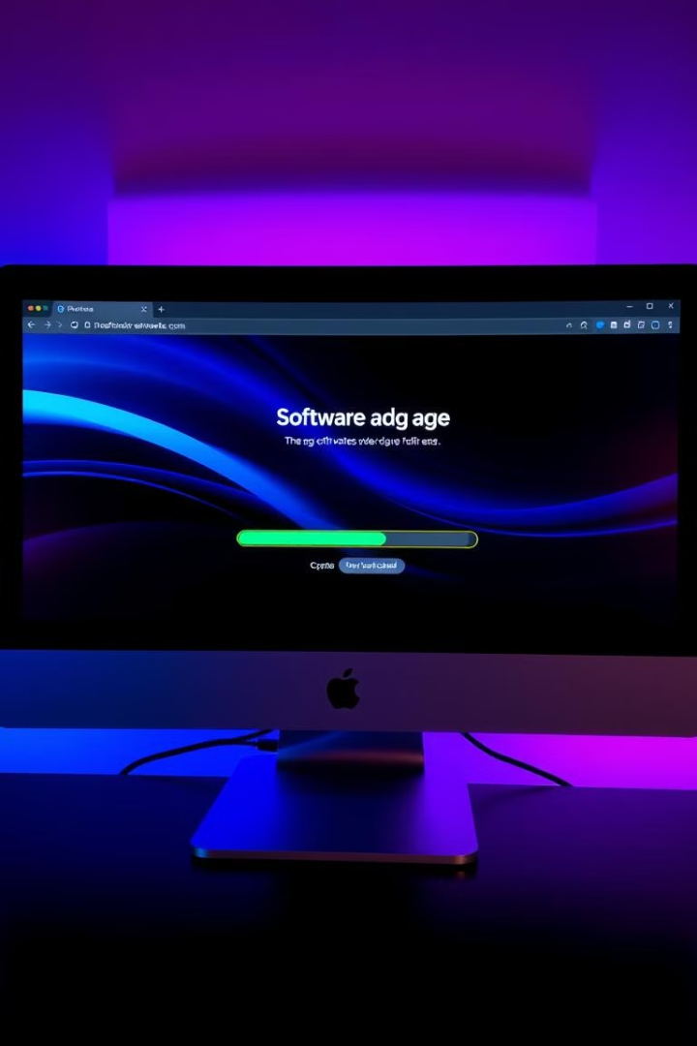



Practical Session: Download and Install Essential Software
Download Essential Software
Participants will be guided on downloading essential software.
Installation Instructions
Step-by-step instructions will be provided for installation.
Software Interface Overview
A brief overview of the software interface will be given.

Slide 7

Q&A and Discussion
Questions
Participants are encouraged to ask questions related to video production and editing.
Career Goals
Discussions on career goals and skills needed for the industry will be fostered.

Slide 8
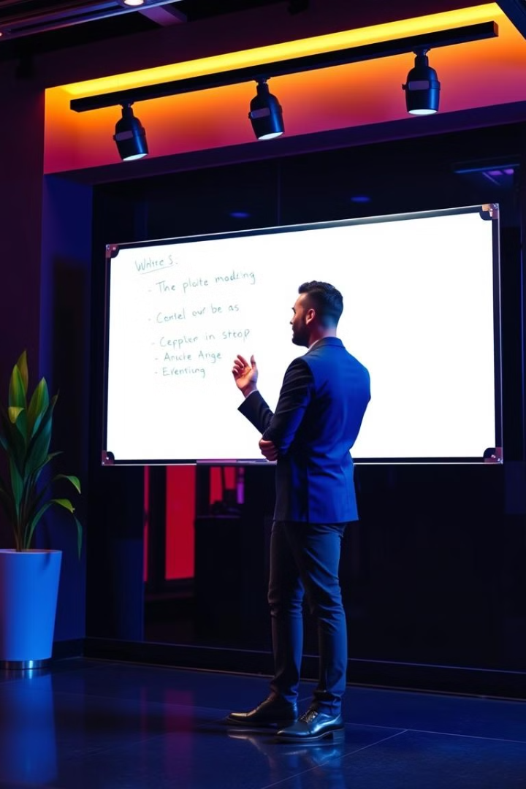
Closing & Next Session Preview
1
Session Recap
The session's topics will be recapped.
2
Next Session Preview
The next session, "Communication Skills & Legal Issues in Video Production," will be previewed.

